Slide 1
Smart Plant Gardening System
Presented by:
Hamad Khan 23-NTU-CS-1098
M. Bilal 23-NTU-CS-1064
M. Dawood Qasir 23-NTU-CS-1065
Presented to:
Dr.Nasir Mehmood

Slide 2
Introduction
Smart gardening uses IoT technology to automate plant care and monitoring.

Slide 3
Problem Statement
Manual watering is difficult when user is away.
Over or under watering damages plants.

Slide 4
Project Objectives
Monitor soil moisture.
Send alerts.
Remote pump control.
Automatic watering.

Slide 5
System Overview
ESP32 reads soil sensor data.
Data sent via WiFi.
User controls pump remotely.

Slide 6
Hardware Components
ESP32
Soil Moisture Sensor
Relay Module
Water Pump

Slide 7
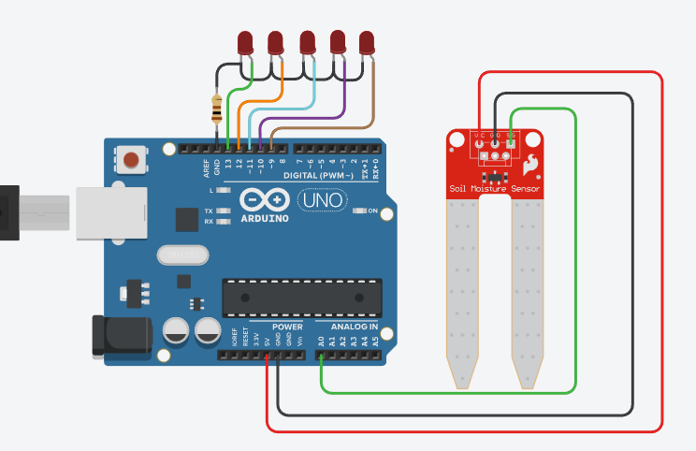
ESP32 Microcontroller
Acts as the brain of the system.
Handles WiFi and sensor processing.

Slide 8
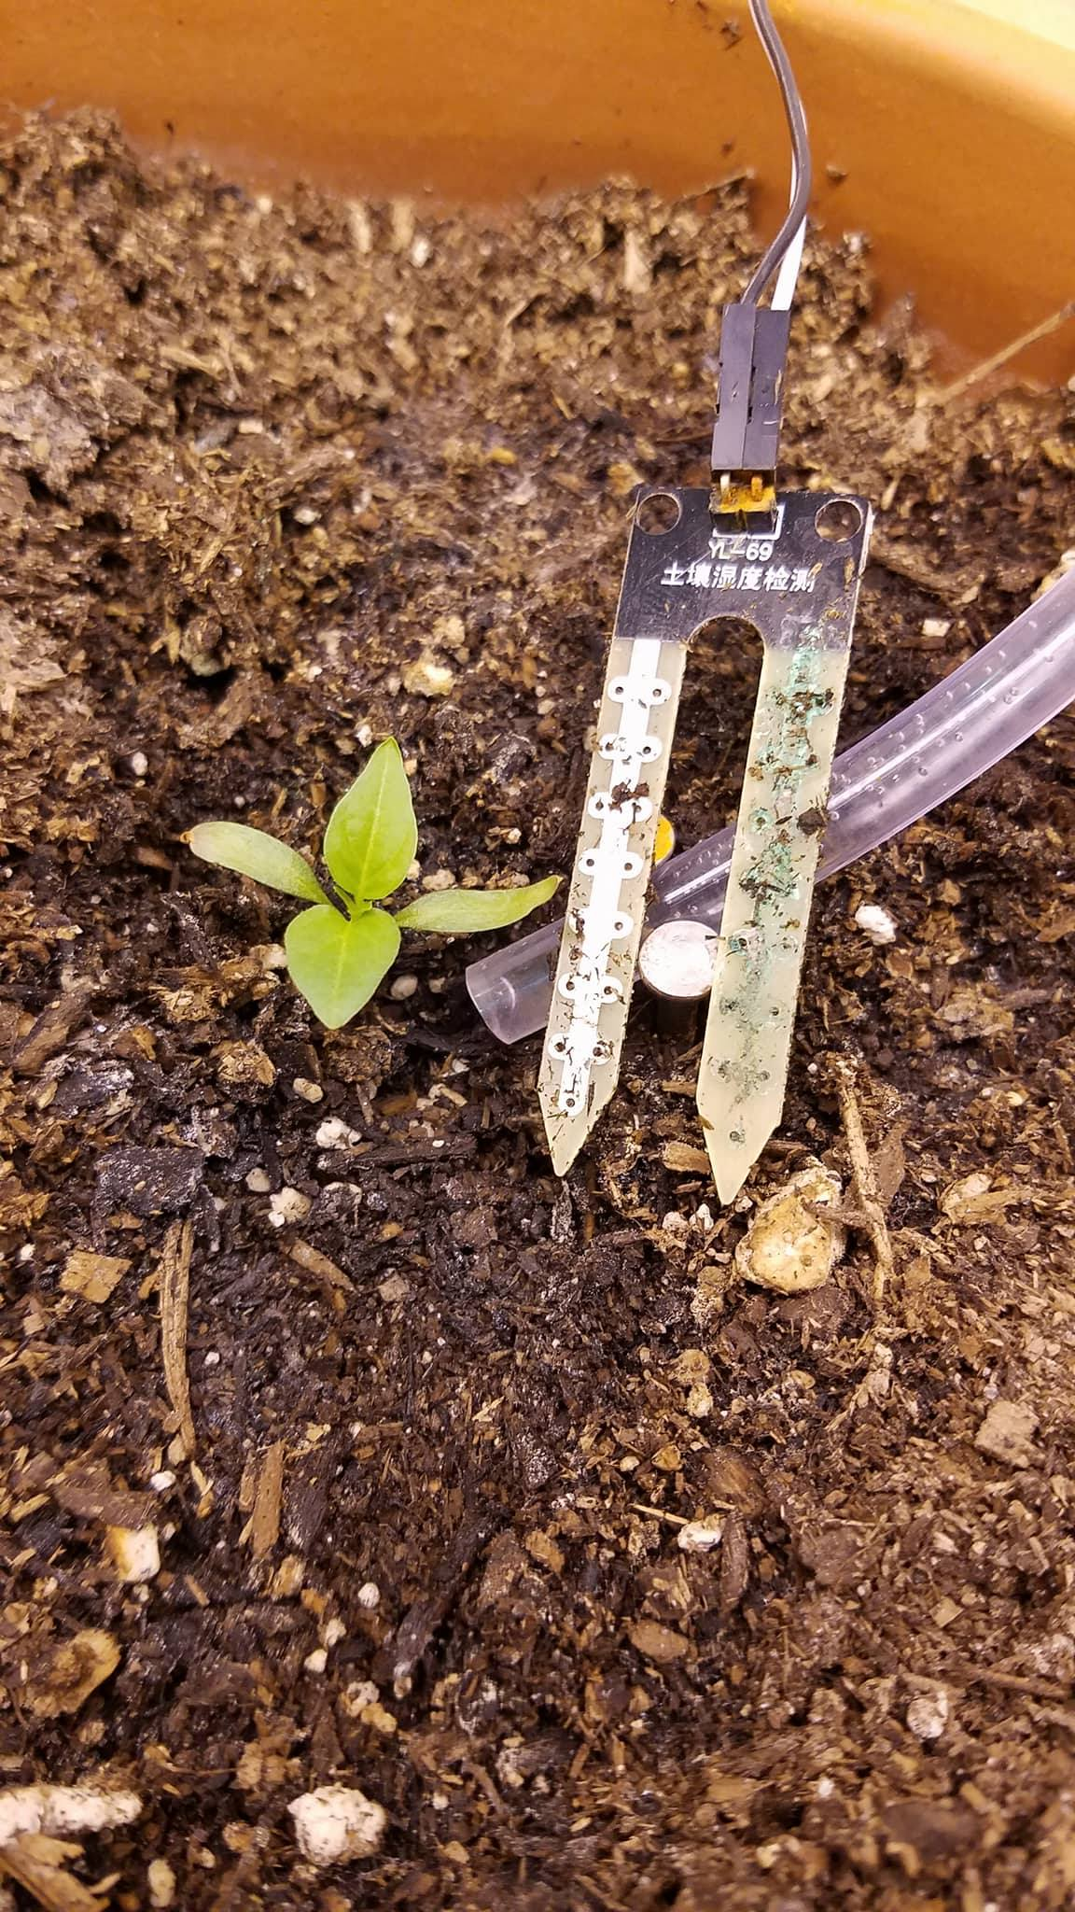
Soil Moisture Sensor
Detects soil water content.
Helps decide watering need.

Slide 9
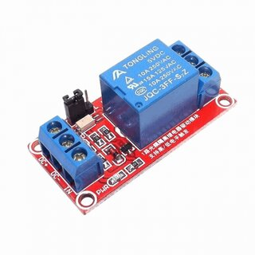
Relay Module
Works as an electronic switch.
Controls high voltage pump safely.

Slide 10
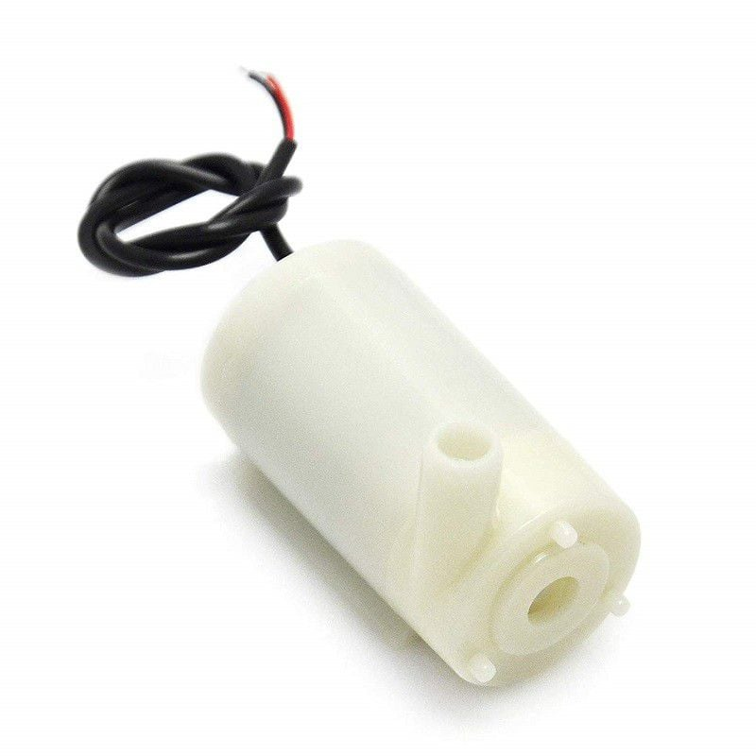
Water Pump
Supplies water to plants.
Controlled automatically or manually.

Slide 11
Software Tools
PlatformIO (VS Code)
Arduino Framework
Blynk IoT Platform

Slide 12
Blynk Mobile App
Remote monitoring.
Pump ON/OFF control.
Real-time updates.

Slide 13
Email Alert System
Uses Gmail SMTP.
Notifies user when soil is dry.

Slide 14
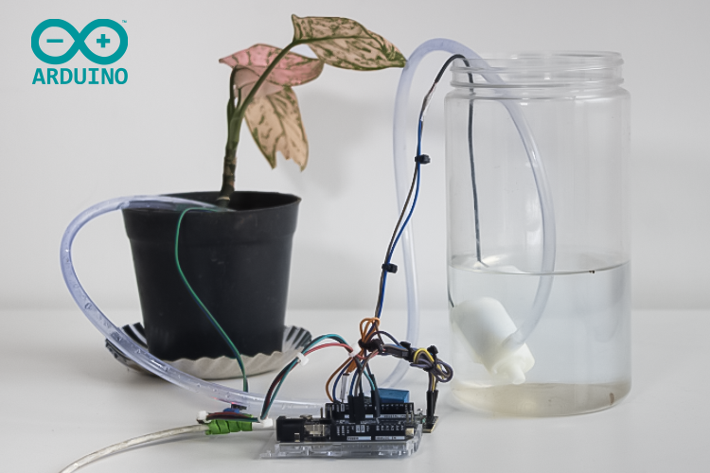
Working Principle
Soil checked continuously.
Email alert on dry soil.
Pump ON via Blynk.
Auto OFF when wet.

Slide 15
Advantages
Water saving.
Remote access.
Low cost.
Easy to use.

Slide 16
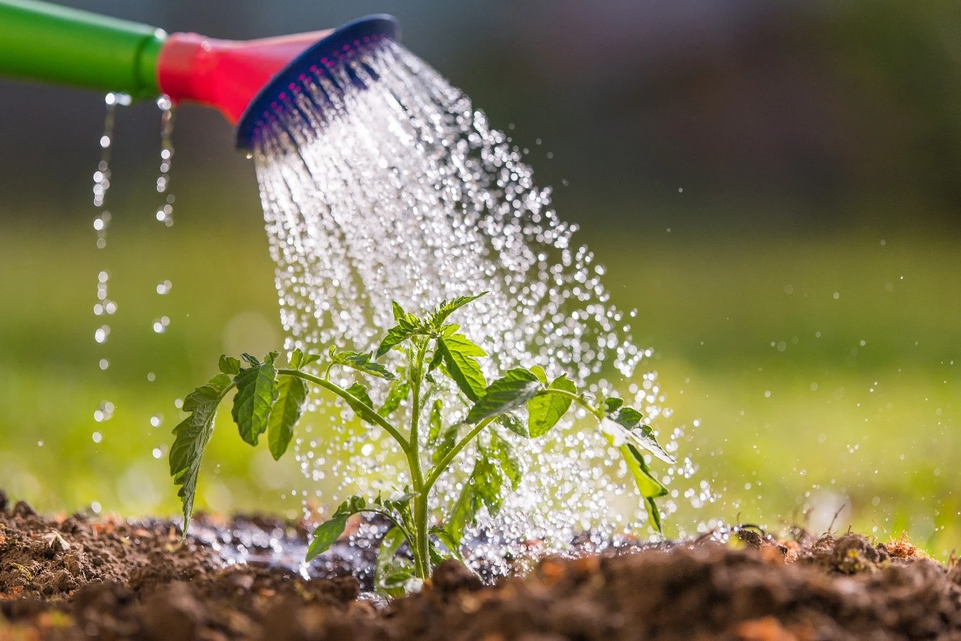
Conclusion
Smart system ensures proper plant care.
Efficient and reliable IoT solution.

Slide 17
Thanku
Have you any question?

